Slide 1

Genetic Algorithms Optimizers

Slide 2
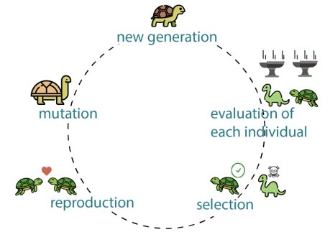
Genetic Algorithms: Overview
Why Genetic Algorithms?
Metaheuristic algorithms stem from biological evolution.
Preferred for non-differentiable, expensive to differentiate, or objective functions with no intrusive access (black-box).
Doesn’t get stuck in local minima, and hence works with non-convex problems.
Can handle both constrained and unconstrained problems.
Due to the encoding/decoding step it works with discrete, continuous, or mixed design spaces, with binary, integer, real, gray, or permutation encoding.
2

Slide 3
Notation
 | G1 | G2 | G3 | G4 | G5
ch1
ch2 | 2 | 5 | 1 | 8 | 4
ch3
ch4
ch5
ch6
ch7
Chromosome/individual (possible solution)
2 | 5 | 1 | 8 | 4
Population
2
Gene (variable)
2
Allele (value of variable)
3

Slide 4
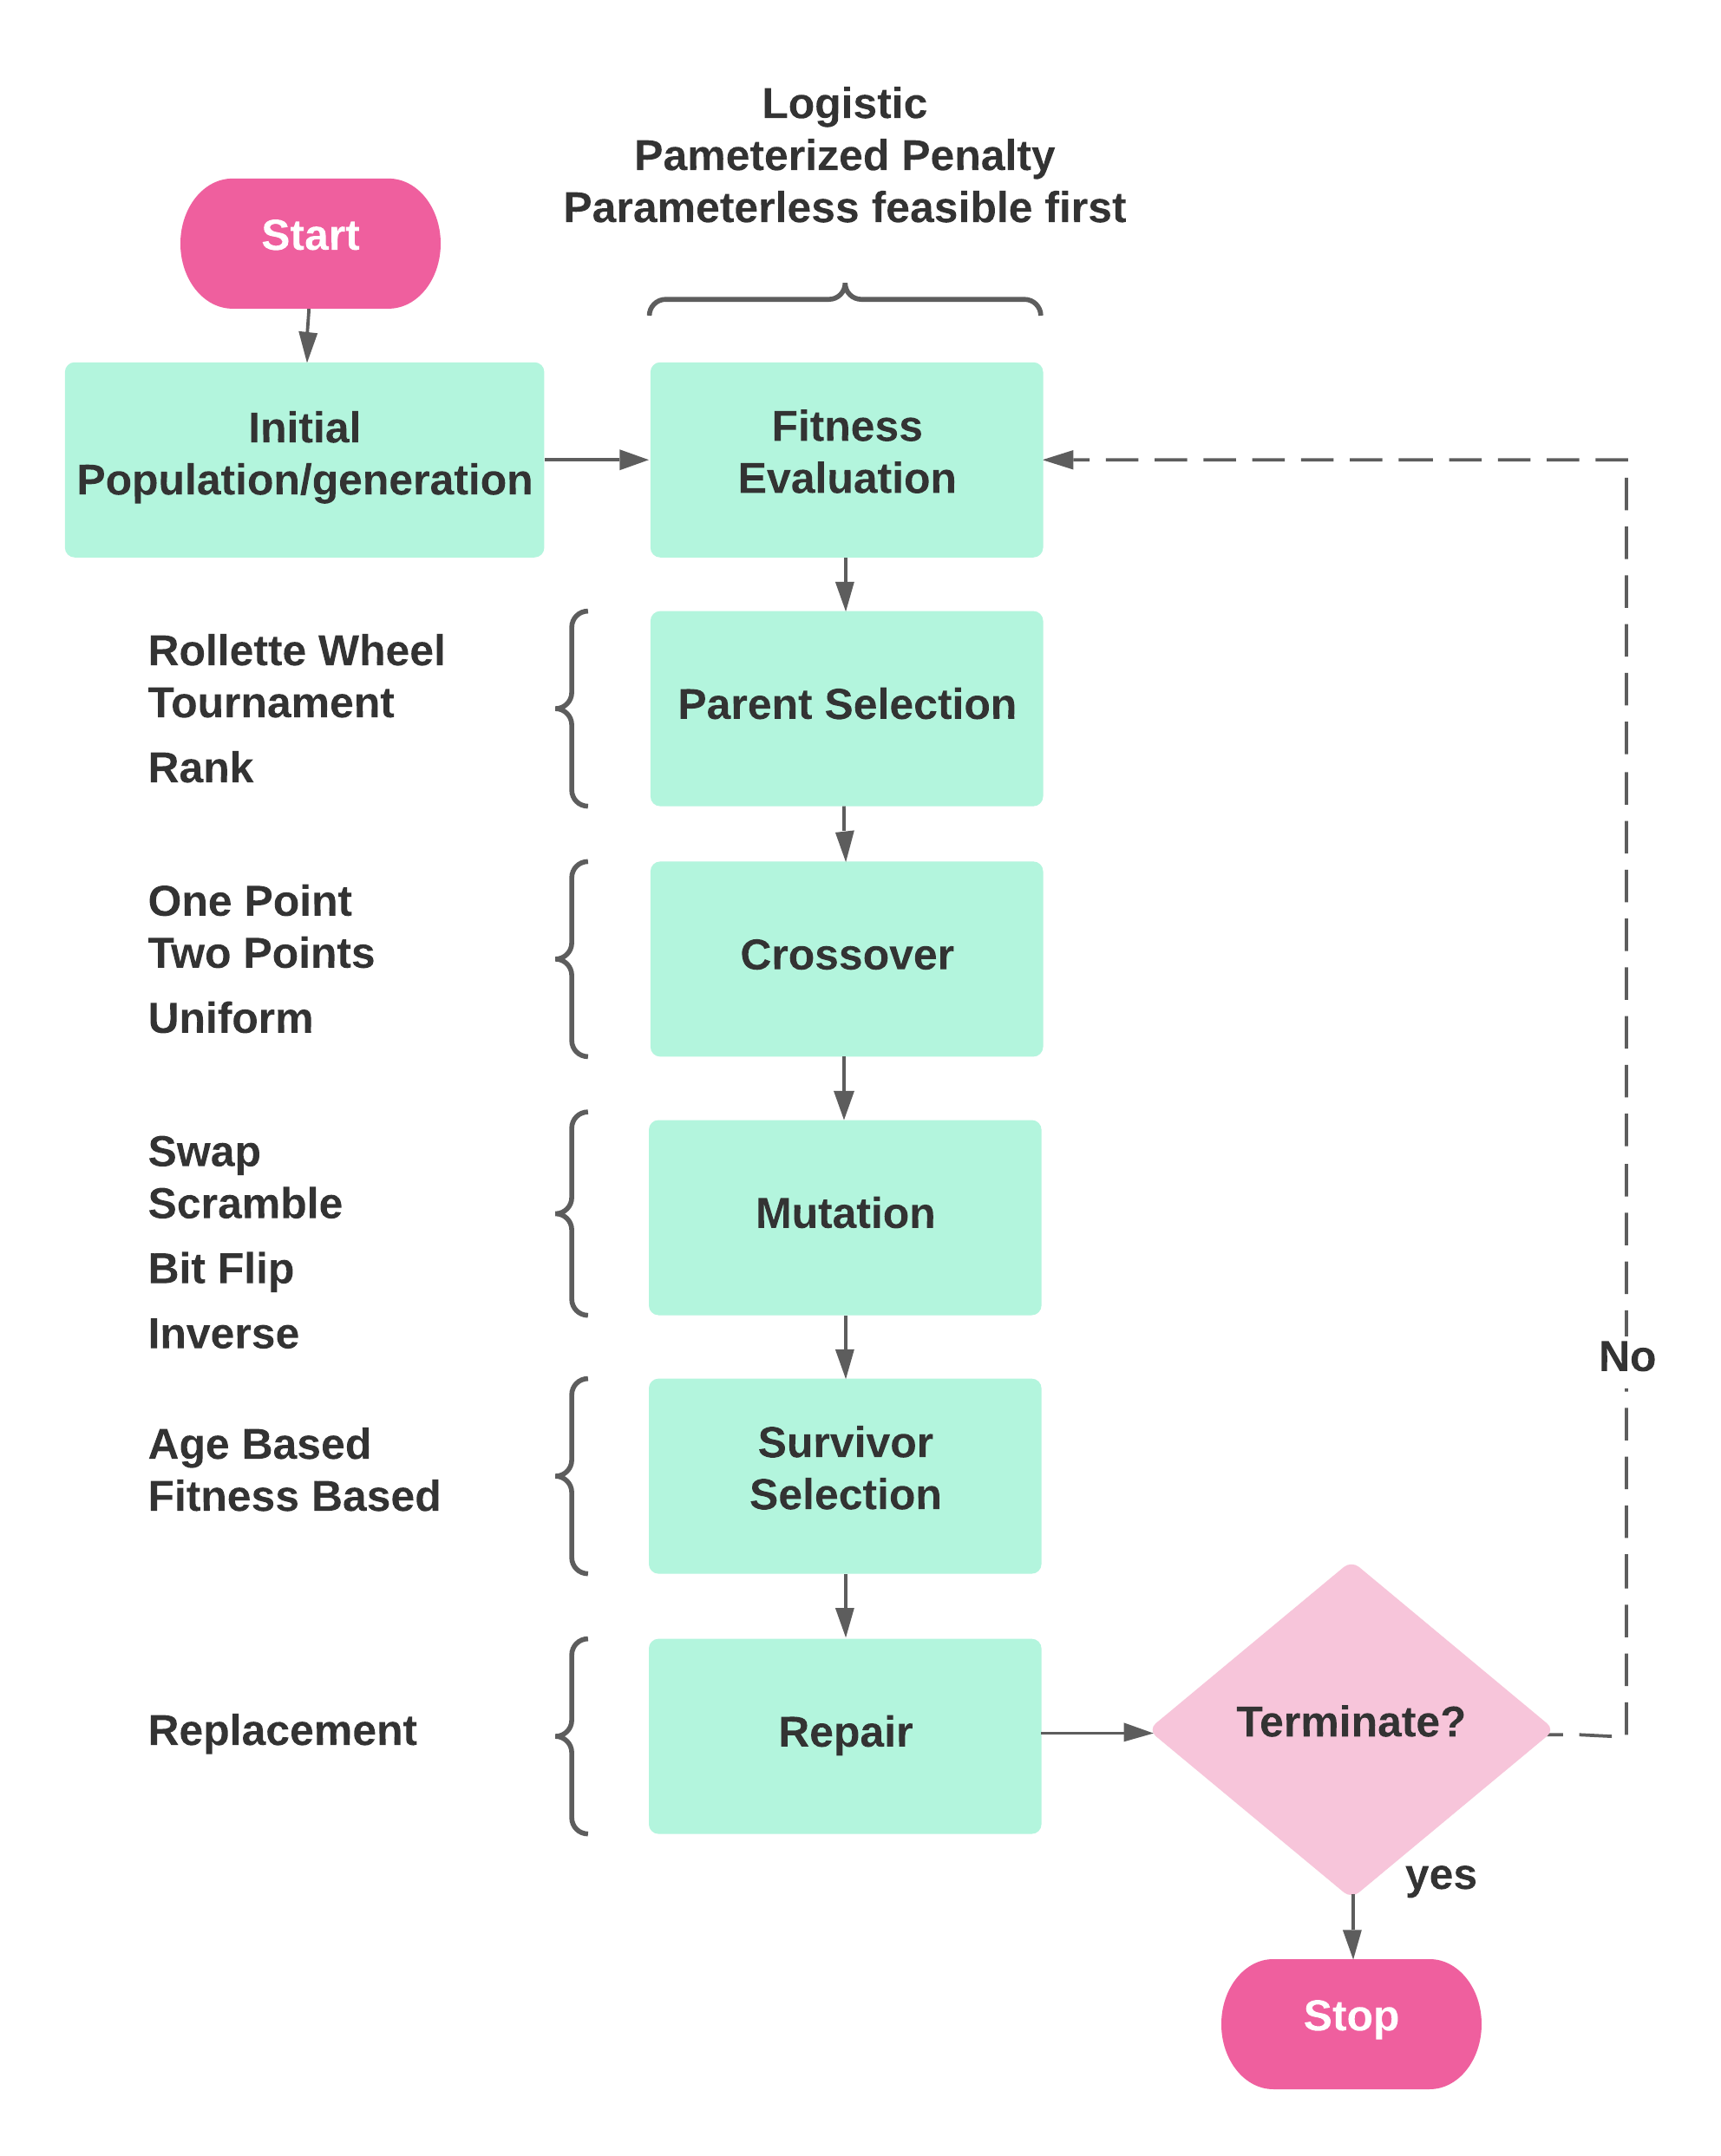
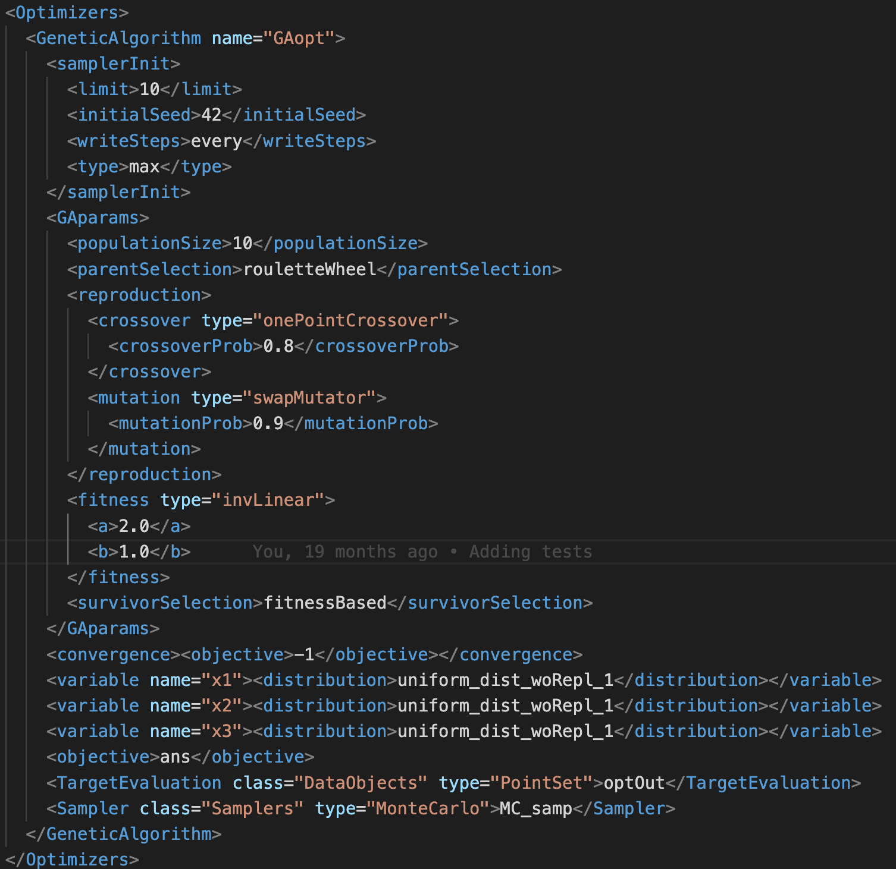
Flowchart and Corresponding Input
4

Slide 5
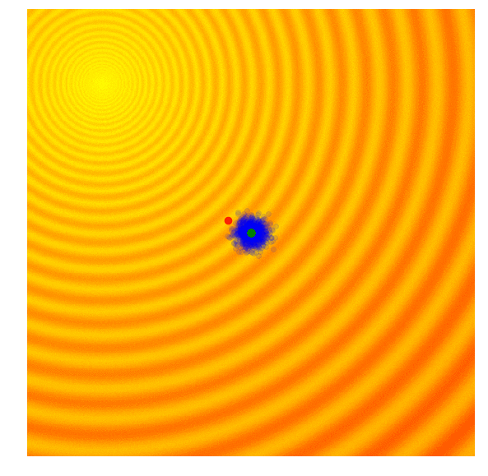
Overview of GAs
Encoding/decoding: Phenotype/Genotype variable representation (binary, integer, permutation, or real representation).
Steps
Create initial population
Fitness evaluation
Parent selection
Crossover: creation of offsprings
Mutation: creation of mutated offsprings
Replacement/repair
Survivor selection
If Termination condition(s) is met terminate, else repeat Steps 3 through 7 (each iteration is a generation).
Source: A Visual Guide to Evolutionary Strategies. https://blog.otoro.net/2017/10/29/visual-evolution-strategies.
5

Slide 6
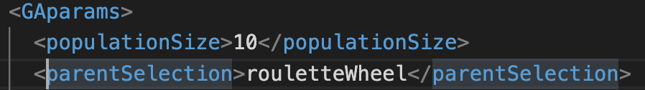
Evolutionary Operators of GAs
Parent selectors:
Roulette Wheel
Tournament Selection
Rank Selection
Individual | Fitness
P1 | 5
P2 | 8.2
P3 | 1.4
P4 | 0.98
P5 | 2
P6 | 2.3
6

Slide 7
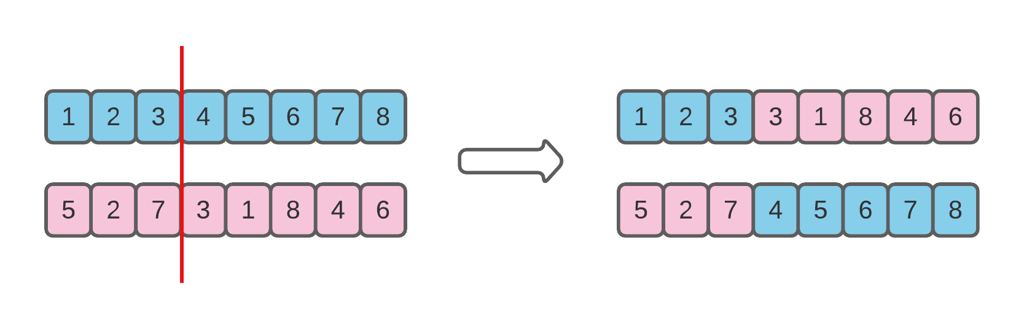
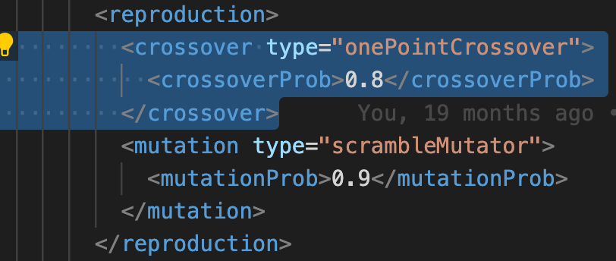
Evolutionary Operators of GAs
Crossovers:
One Point
Two points
Uniform
7

Slide 8
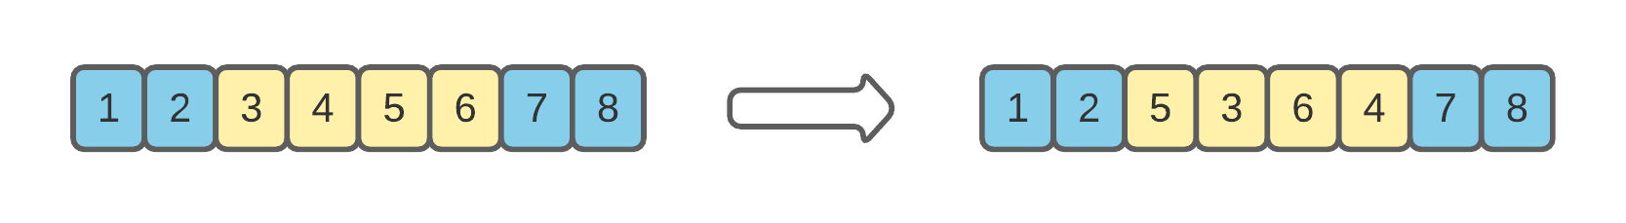
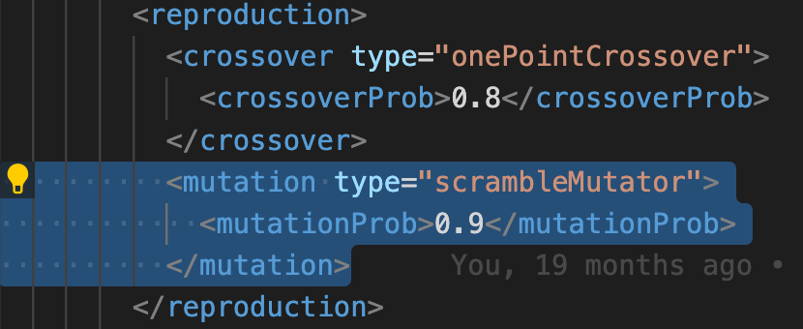
Evolutionary Operators of GAs
Mutators:
Swap Mutation
Scramble Mutation
Bit Flip Mutation
Inversion Mutation
8

Slide 9
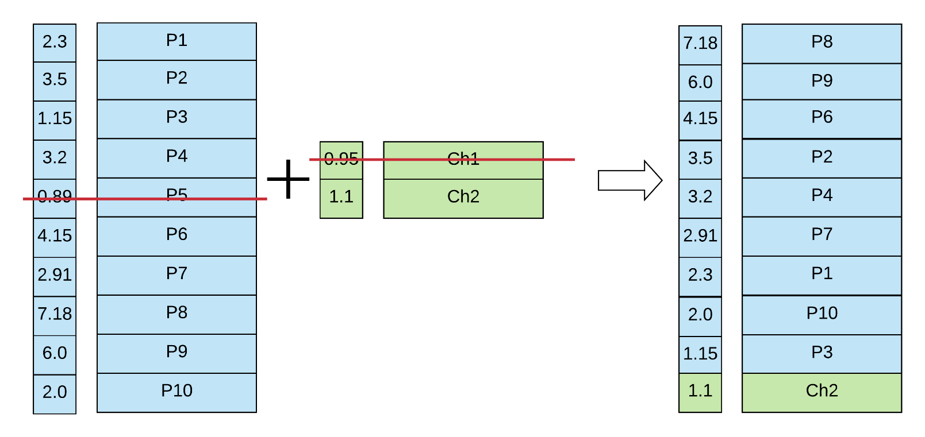
Evolutionary Operators of GAs
Survivor selection:
Fitness Based
Age Based
Fitness
Fitness
Chromosome
Chromosome
Fitness
Chromosome
offsprings
Generation/population i
Generation/population i+1
9

Slide 10
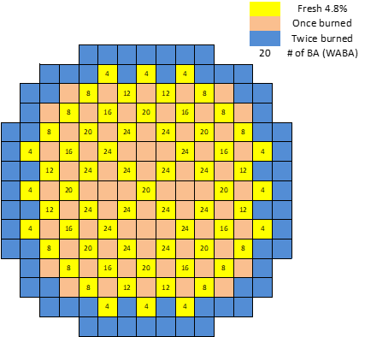
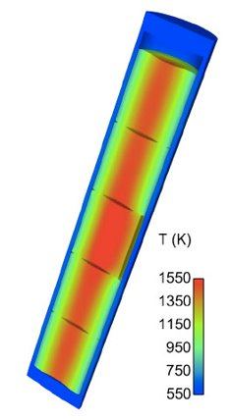
Demonstration: Initial Loading Simplified Problem
Settings:
1/4th of the core (PWR)
56 variables (56 assembly locations to arrange)
5 Materials (5 assembly types to “choose” from):
Material - 1: Enrichment 2.2% in U235, No burnable poisons
Material – 2: Enrichment 2.5% in U235, No burnable poisons
Material – 3: Enrichment 2.5% in U235, burnable poisons (8.e-06 #/(cm*barn))
Material – 4: Enrichment 3.5% in U235, No burnable poisons
Material – 5: Enrichment 3.5% in U235, burnable poisons (8.e-06 #/(cm*barn))
Objective:
Maximization of cycle length
The cycle length is determined based on a criticality search calculation (Soluble Boron Search): if SB <= 5 ppm, cycle ends
2D – Benchmark configuration
10

Slide 11

Data Flow in Fuel Reload Optimization Platform
Genetic Algorithm
[Constraints]
Design limits
Safety goals
[Objectives]
Max. energy production
Min. fuel cost
Core specification
Fuel inventory
Perturbed input files
EFPD, Burnup, HCF
Boron concentration
Additional metadata
DBA scenarios
Core map and data
Perturbed input files
Safety parameters
PCT, DNBR, HTC
Additional metadata
Fuel rod modeling
Core and TH data
Perturbed input files
PCT, RIP, Oxidation
FFRD related data
Additional metadata
Core Design (e.g., PARCS and SIMULATE)
System Analysis (RELAP5-3D)
Fuel Performance (TRANSURANUS)
Risk-Informed Multi-Physics Uncertainty Analysis
EFPD: Effective full power day
HCF: Hot channel factor
DBA: Design basis accident
PCT: Peak cladding temperature
DNBR: Departure of nucleate boiling rate
HTC: Heat transfer coefficient
TH: Thermal-hydraulics
RIP: Rod internal pressure
FFRD: Fuel failure, relocation and dispersal

Slide 12
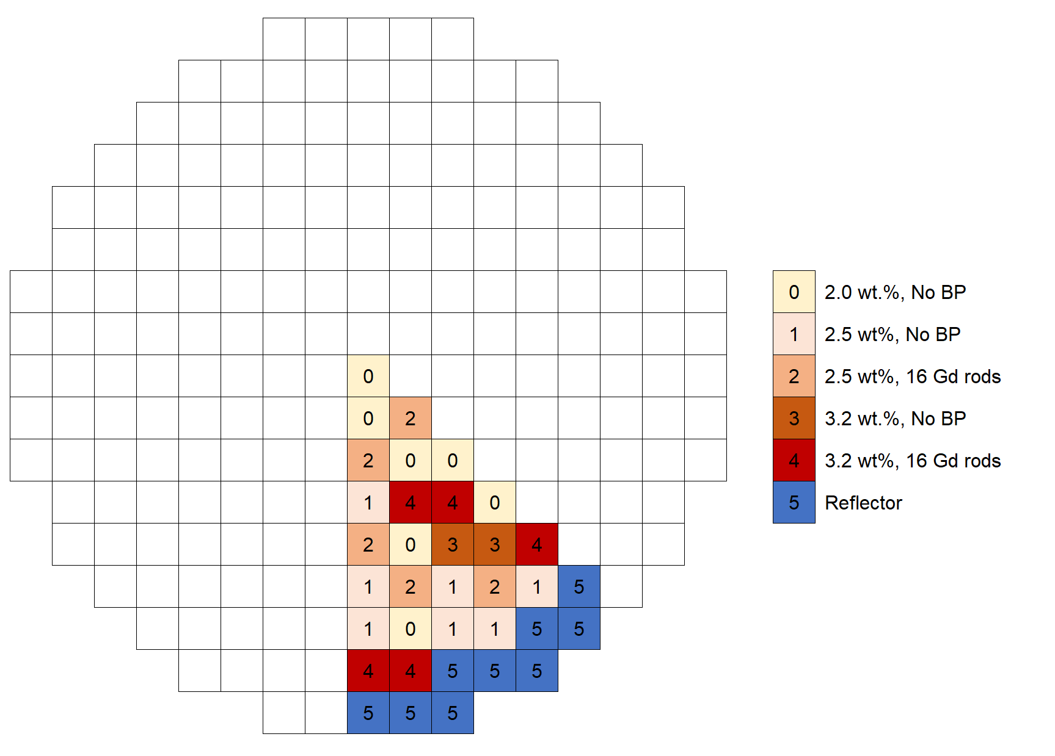
Case Study: Single-objective Optimization for Core Design Introduction
Settings
PWR core with 157 fuel assemblies (FA)
Quarter-core symmetry
6 FA designs → design space = 7.1⨉10³²
200 Population w/ 90 Iteration for GA
Exemplary 1/8 Core of a generic PWR
Fuel type ID | 0 | 1 | 2 | 3 | 4 | 5
Enrichment (wt%) | 2 | 2.5 | 2.5 | 3.2 | 3.2 | Reflector
Burnable poison | None | None | 16 Gd rods | None | 16 Gd rods | -
Objectives
Maximize cycle length (cycle energy production)
Constraints
F_{Q} (Heat flux hot channel factor) < 2.1
F_{ΔH} (Nuclear enthalpy rise hot channel factor) < 1.48
Peak critical boron concentration (CBC) <1300 pcm
NOTE: F_{Q} and F_{ΔH} are peaking factors used to characterize core power distribution in terms of ratios of local maximum power output to average core output.

Slide 13
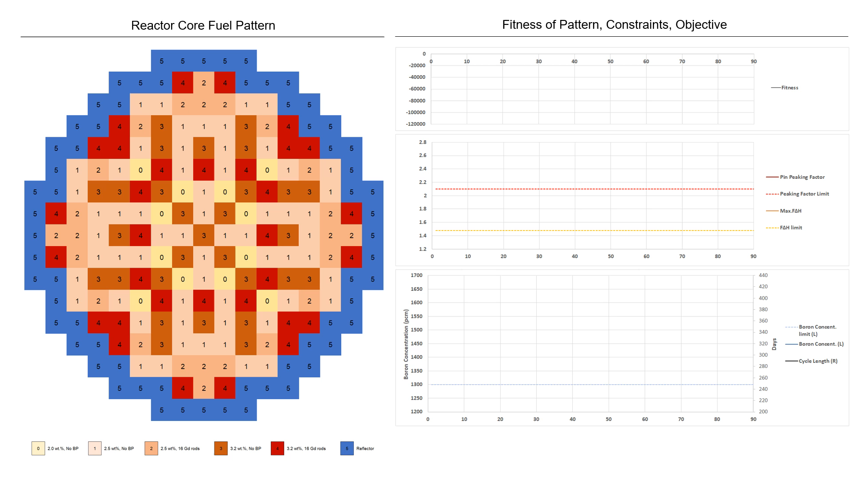
Case Study: Single-objective Optimization for Core Design Demonstration

Slide 14
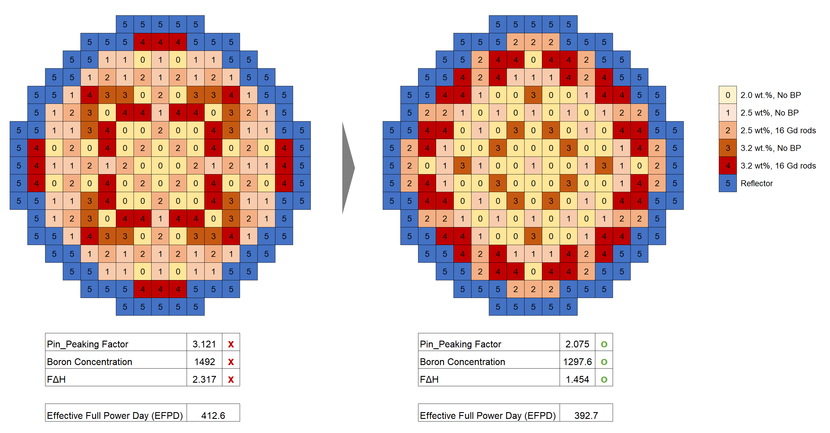
Case Study: Single-objective Optimization for Core Design Demonstration
Initial Fuel Loading Pattern
Optimized Fuel Loading Pattern

Slide 15
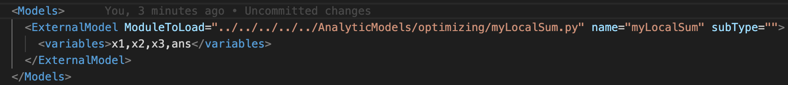
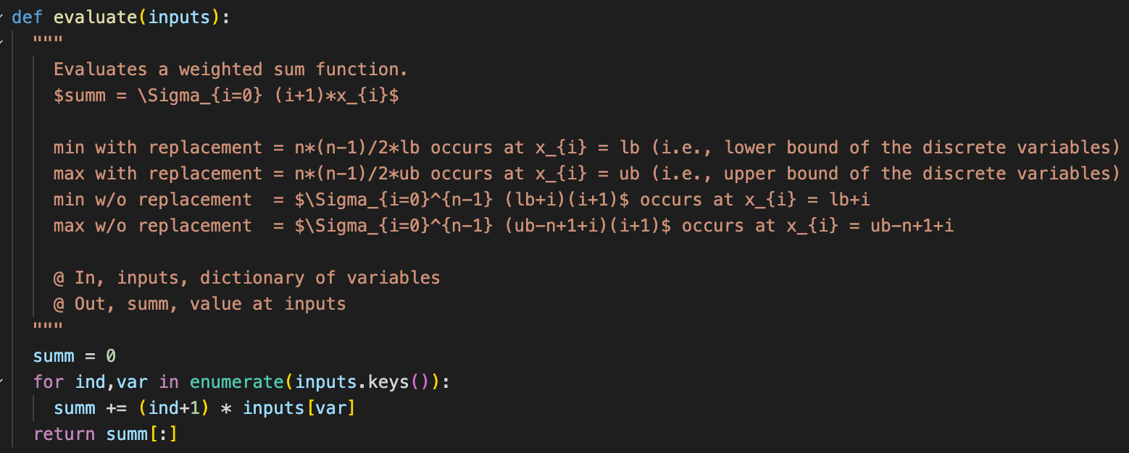
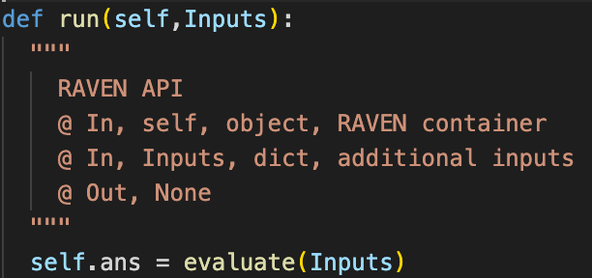
User-defined objective function via external models
RAVEN XML Input
External Model
15

Slide 16
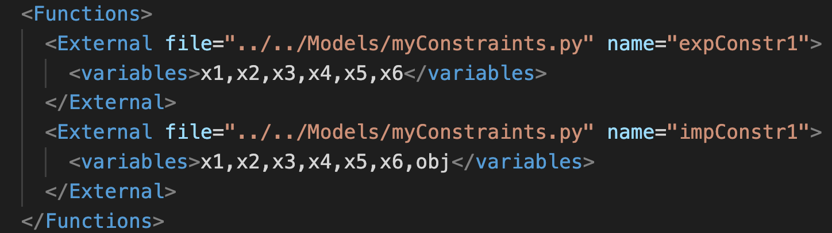
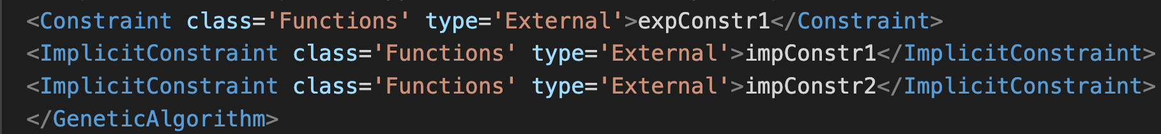
User-defined Constraints in the external model/and Functions
RAVEN XML Input
In <optimizer>:
16

Slide 17
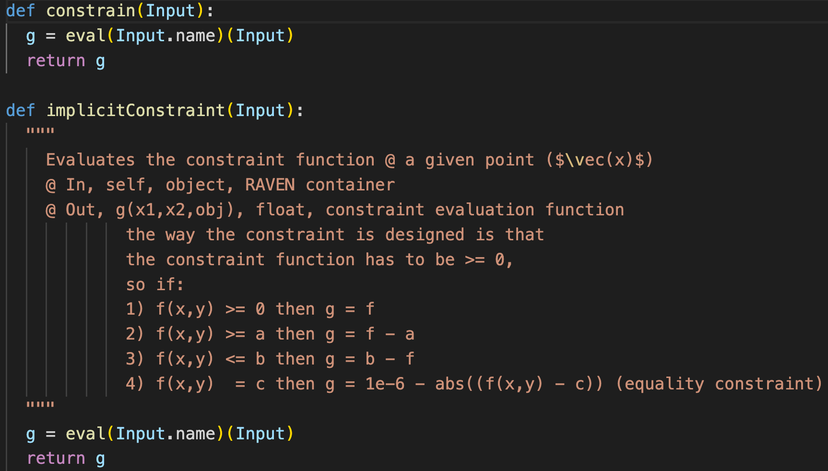
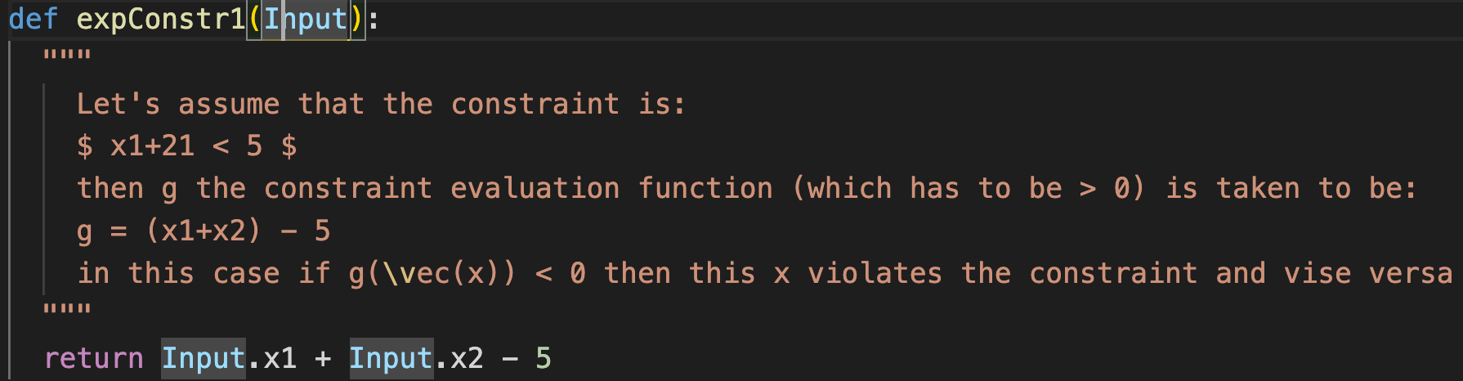
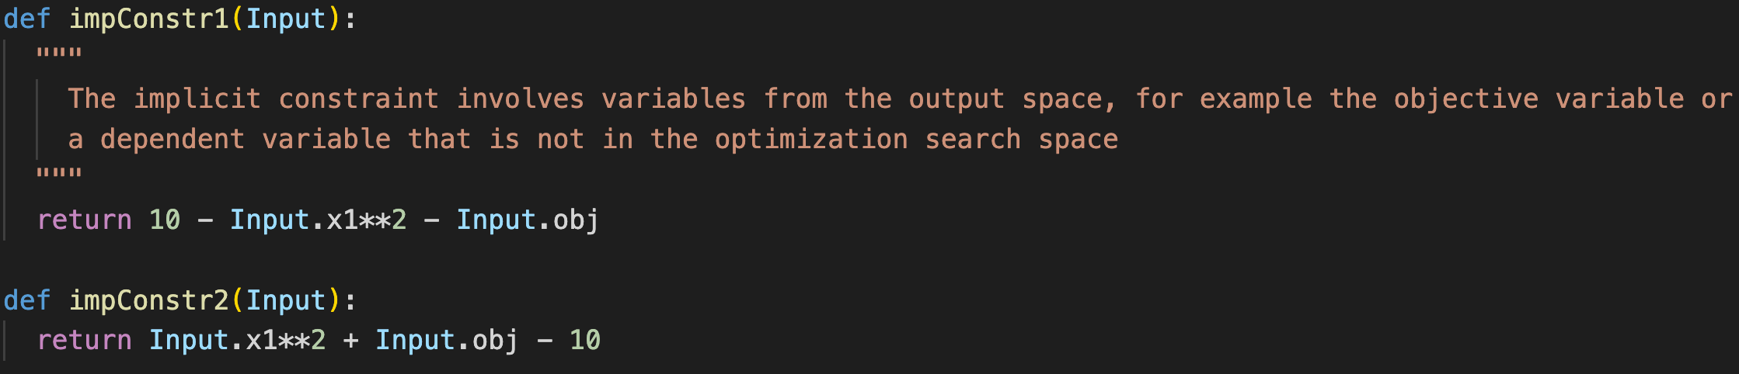
User-defined Constraints in the external model/and Functions
Must be exactly named
Must be consistent with xml
17

Slide 18
Hands-on Session
18

Slide 19
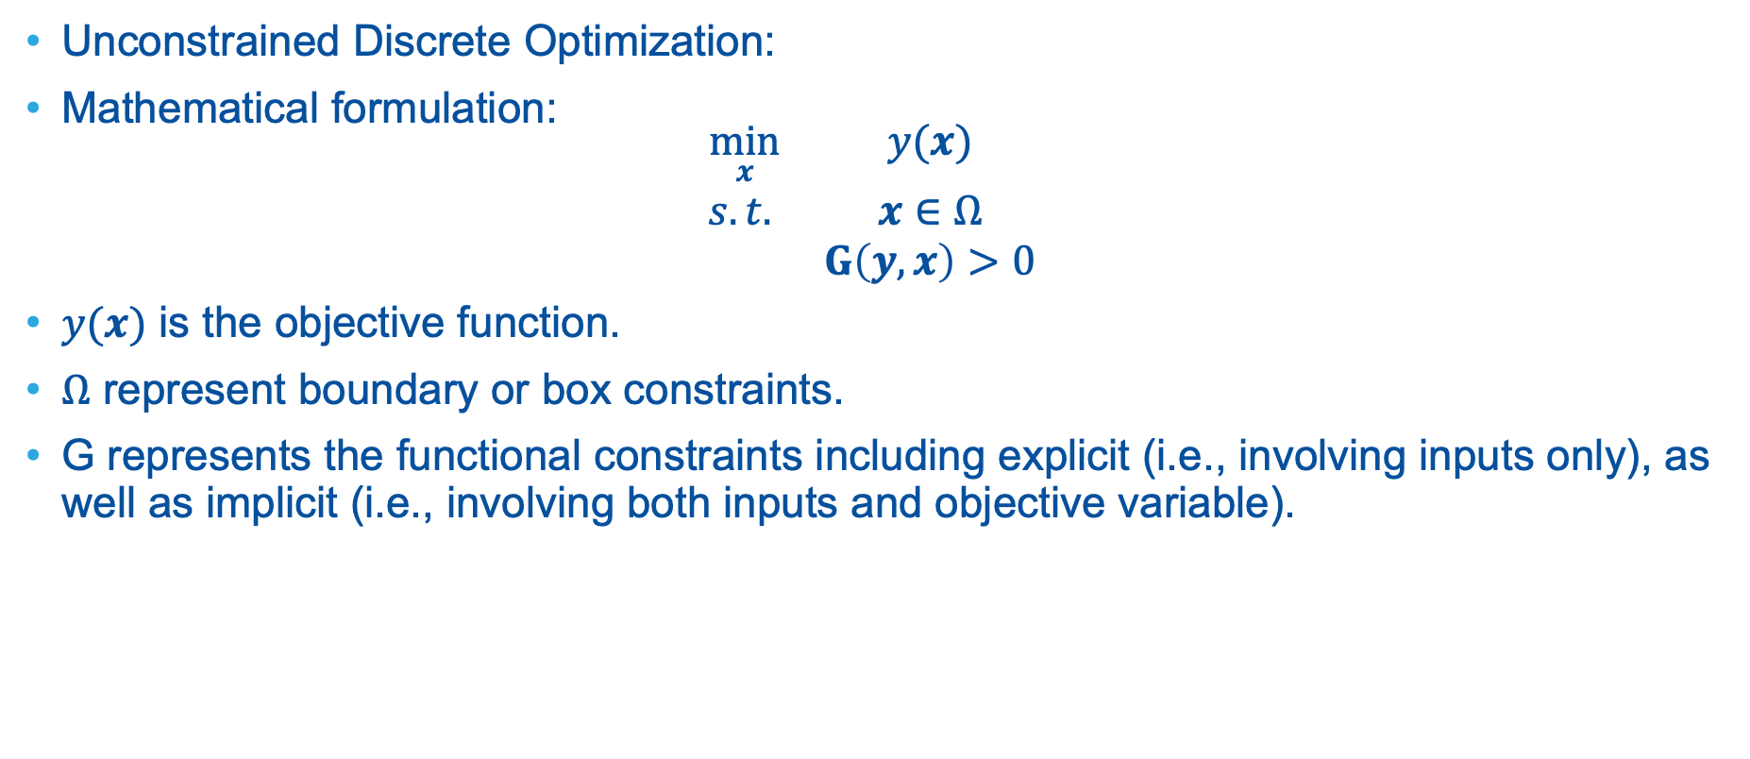
Hands-on session
Unconstrained Discrete Optimization:
Mathematical formulation:
$$\begin{matrix}\min_{x} & y(x) \\ s.t. & x∈Ω \\ & G\left(y,x\right)>0\end{matrix}$$
$y(x)$ is the objective function.
$Ω$ represent boundary or box constraints.
G represents the functional constraints including explicit (i.e., involving inputs only), as well as implicit (i.e., involving both inputs and objective variable).
19

Slide 20
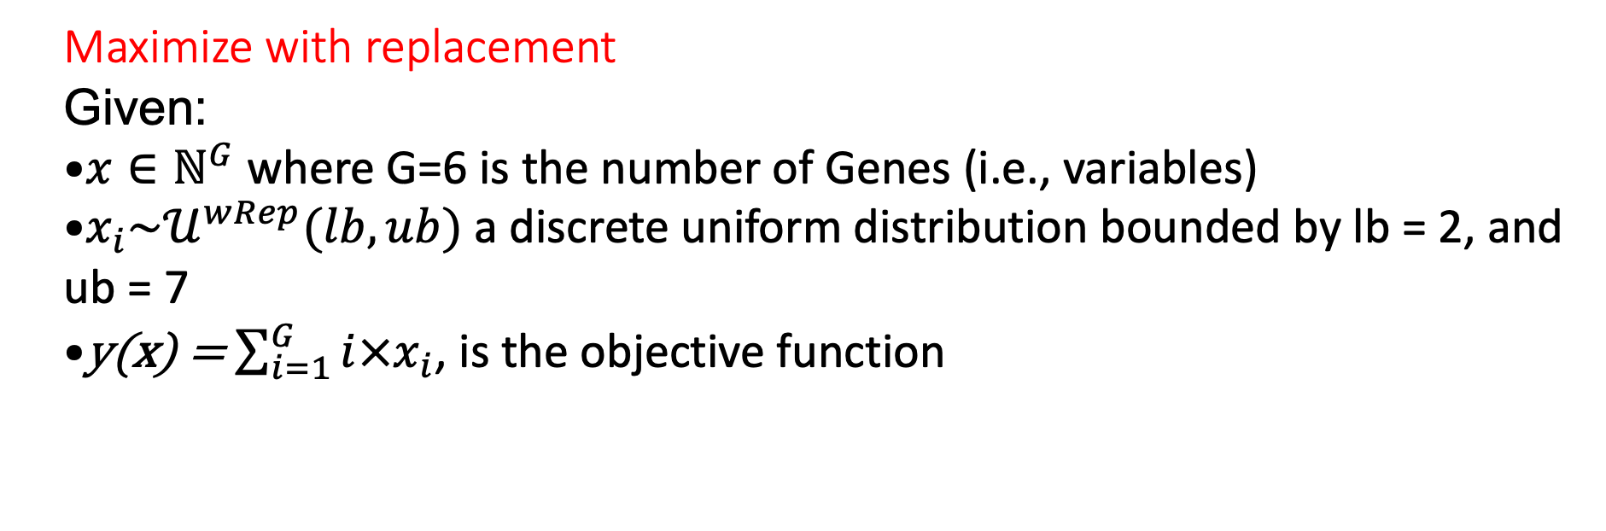
Exercise1 (1_GA_MaxwRep.xml)
Maximize with replacement
Given:
$x∈ℕ^{G}$ where G=6 is the number of Genes (i.e., variables)
$x_{i}\sim 𝒰^{wRep}(lb,ub)$ a discrete uniform distribution bounded by lb = 2, and ub = 7
y(x) = $\sum_{i=1}^{G}{i×x_{i}}$, is the objective function
20

Slide 21
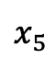
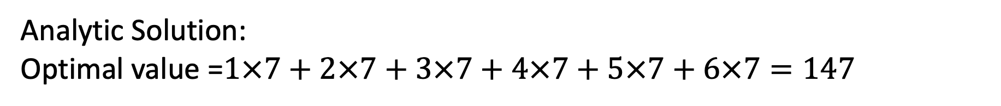
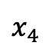
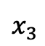
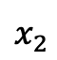
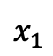
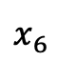
Exercise1 (1_GA_MaxwRep.xml)
Procedure: change directory (cd) to: ~/projects/raven/doc/workshop/optimizer/GeneticAlgorithms/exercises/ (For windows you might need to add double quotes)
Add a uniform discrete distribution that uses a “withReplacement” strategy.
Enable ‘onePointCrossover’ to occur 80% of the time and ‘swap mutation’ 90% of the time.
Build your objective function shown in the starter xml. (Hint use slide 13)
Add an objective function name in the xml that is consistent with your external model.
Run using the command: raven_framework 1_GA_MaxRep.xml
Analytic Solution:
Optimal value =$1×7+2×7+3×7+4×7+5×7+6×7=147$
7 | 7 | 7 | 7 | 7 | 7
$$x_{1}$$
$$x_{2}$$
$$x_{3}$$
$$x_{4}$$
$$x_{5}$$
$$x_{6}$$
21

Slide 22
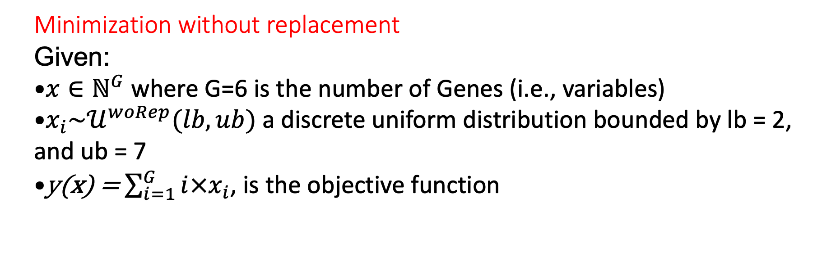
Exercise2 (2_GA_MinRep.xml)
Minimization without replacement
Given:
$x∈ℕ^{G}$ where G=6 is the number of Genes (i.e., variables)
$x_{i}\sim 𝒰^{woRep}(lb,ub)$ a discrete uniform distribution bounded by lb = 2, and ub = 7
y(x) = $\sum_{i=1}^{G}{i×x_{i}}$, is the objective function
22

Slide 23
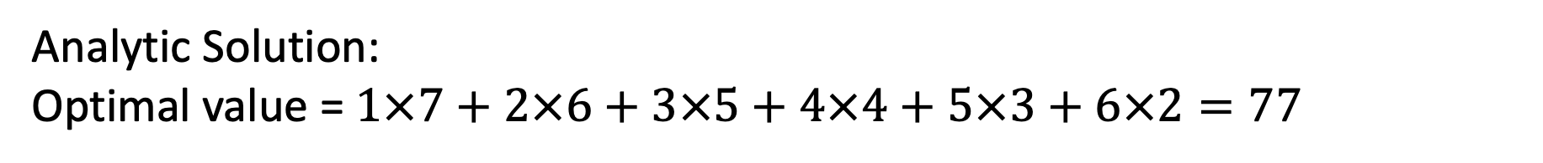
Exercise2 (2_GA_MinwoRep.xml)
Procedure:
Pick ‘rouletteWheel’ as the parent selector.
Set ‘survival selection’ criterion to ‘fitnessBased’
Set population size to 20 and max number of iterations (samplerInit limit to 15)
Run: raven_framework 2_GA_MinwoRep.xml
Analytic Solution:
Optimal value = $1×7+2×6+3×5+4×4+5×3+6×2=77$
7 | 6 | 5 | 4 | 3 | 2
$$x_{1}$$
$$x_{2}$$
$$x_{3}$$
$$x_{4}$$
$$x_{5}$$
$$x_{6}$$
23

Slide 24
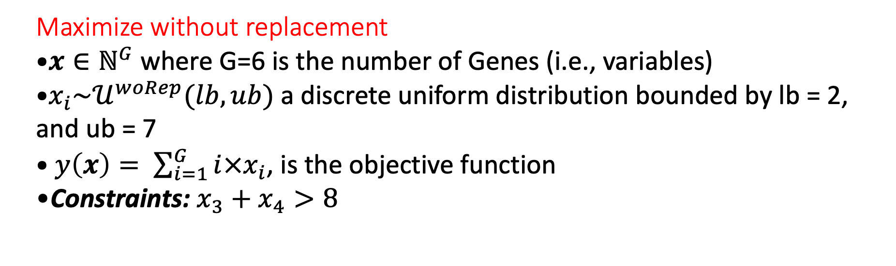
Exercise3 (Maximization with explicit constraints) start from the starter exercise 2
Maximize without replacement
$x∈ℕ^{G}$ where G=6 is the number of Genes (i.e., variables)
$x_{i}\sim 𝒰^{woRep}(lb,ub)$ a discrete uniform distribution bounded by lb = 2, and ub = 7
$y\left(x\right)= \sum_{i=1}^{G}{i×x_{i}}$, is the objective function
Constraints: $x_{3}+x_{4}>8$
24

Slide 25
Exercise3
Procedure:
Go to Models/Constraints.py and name the first function ‘constrain’ this is a must since RAVEN searches for that exact word
Give the first explicit constraint function a name and make sure it is the same name you use in the XML. And implement the constraint x3 + x4 < 8.
Look at the second explicit constraint (Not used in the exercise).
In the XML starter input, Complete the functions block to define your constraint functions.
In the fitness block, change the penalty weighting of violation b to 20.
Fill the Constraint node at the end of the GA block to reflect the name of your constraint function.
25

Slide 26
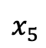
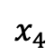
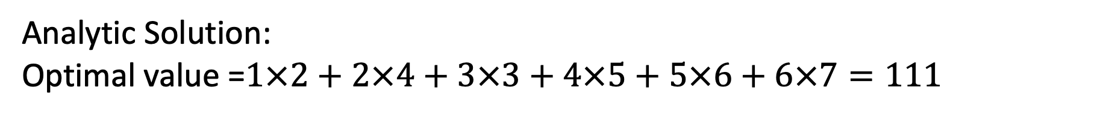
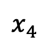
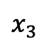
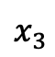
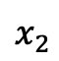
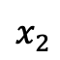
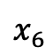
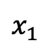
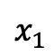
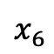
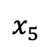
Exercise3 (Max w/o Rep with Constraints)
Analytic Solution:
Optimal value =$1×2+2×4+3×3+4×5+5×6+6×7=111$
2 | 3 | 4 | 5 | 6 | 7
2 | 4 | 3 | 5 | 6 | 7
Unconstrained:
Constrained:
$$x_{1}$$
$$x_{2}$$
$$x_{3}$$
$$x_{4}$$
$$x_{5}$$
$$x_{6}$$
$$x_{1}$$
$$x_{2}$$
$$x_{3}$$
$$x_{4}$$
$$x_{5}$$
$$x_{6}$$
Raven’s Solution:
26

Slide 27
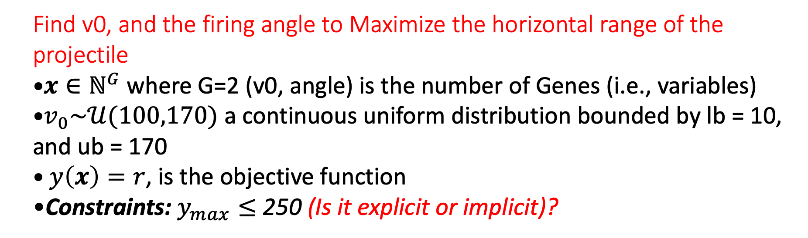
Exercise4 (Continuous problem with implicit constraint)
Find v0, and the firing angle to Maximize the horizontal range of the projectile
$x∈ℕ^{G}$ where G=2 (v0, angle) is the number of Genes (i.e., variables)
$v_{0}\sim 𝒰(100,170)$ a continuous uniform distribution bounded by lb = 10, and ub = 170
$y\left(x\right)=r$, is the objective function
Constraints: $y_{max}≤$ 250 (Is it explicit or implicit)?
27

Slide 28
Exercise4 (Continuous problem with implicit constraint)
Procedure:
Add the missing variable to the <Models>and <Functions> blocks
Change the fitness to ‘feasibleFirst’ and the weight of the penalty (b) to 20
Fill the <ImplicitConstraint> to match the <Functions>
Add the missing variable to the <DataObjects>, and <OutStreams>
28

Slide 29
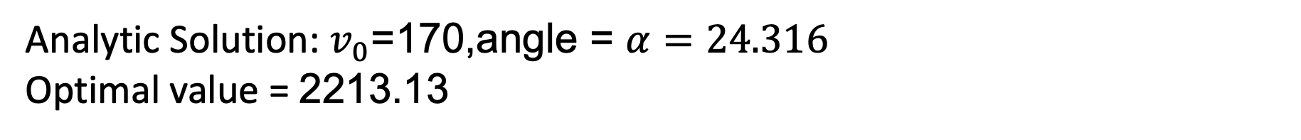



Exercise4 (Continuous problem with implicit constraint)
Analytic Solution: $v_{0}$=170,angle = $α=24.316$
Optimal value = 2213.13
170 | 24
$$x_{opt}$$
$$v0$$
$$theta$$
Raven’s Solution:
29

Slide 30


Exercise4 (Continuous problem with implicit constraint)
30

Slide 31

Non-Dominated Sorting Genetic Algorithm-II (NSGA-II)
NSGA-II is…
Multi-objective, fast non-dominated sorting elite GA
Why NSGA-II?
Lower computational complexity than NSGA-I
Population diversity is guaranteed.
One of the multi-objective evolutionary computation benchmark
Multi-objective optimization problem subject to constraints
Multi-objective optimization technique
Multiple optimal solutions
A multi-objective optimization problem can be written as
Minimize (or maximize) ${\left(f_{1}\left(\text{x}\right), f_{2}(\text{x}),…, f_{M}(\text{x})\right)}^{T}$
Subject to
$$g_{j}\left(x\right)≥\left(or ≤\right) 0$$
$$h_{k}\left(x\right)=0$$
$$x_{i}^{(L)}≤x_{i}^{}≤x_{i}^{(U)}$$
$f_{m}\left(x\right)$ is m-th objective, where m = 1, 2, …, M.
$g_{j}\left(x\right)$ is j-th inequality constraint, where j = 1, 2, …, J
$h_{k}\left(x\right)$ is k-th equality constraint, where k = 1, 2, …, K
x = ${(x_{1}^{},x_{2}^{},…,x_{n}^{})}^{T}$ is a n-dimensional vector
$x_{i}^{(L)}$ and $x_{i}^{(U)}$ are the lower and upper bounds on i-th variable
Higher-level information (or operator’s decision)
One optimal solution

Slide 32
Non-Dominated Sorting Genetic Algorithm-II: Workflow
Parent selection
Start
Crossover
offspring created
Initialize population (size N)
Mutation
Evaluate objectives and constraints
Evaluate objectives & constraints
Combine parents and offspring
Rank population (based on rank and crowding Distance)
Rank population
(based on rank and crowding Distance)
No
Elitism
Terminate?
Select N individuals
Yes
Stop

Slide 33




Non-Dominated Sorting Genetic Algorithm-II: Elitism
Feasible region
Keep the best chromosomes from parent and offspring population
Elitism does not allow an already found optimal solutions to be deleted.
Parent
Offspring
Minimize $f_{2}$
Non-convex area
Pareto front
$f_{1}$ : first objective function
$f_{2}$ : second objective function
Minimize $f_{1}$

Slide 34




Non-Dominated Sorting Genetic Algorithm-II: Dominance Depth Method
Assign rank to each chromosome using the dominance depth
Non-dominated points belong to first rank.
The non-dominated solutions from remainder are in second rank, and so on.
Minimize $f_{2}$
Minimize $f_{2}$
Front-4
Front-3
Front-2
Front-1
Minimize $f_{1}$
Minimize $f_{1}$

Slide 35


Non-Dominated Sorting Genetic Algorithm-II: Niching for the first rank
Niching gives preference to chromosomes that are not crowded.
Crowding distance measures crowdedness of a chromosome w.r.t. its neighbors lying on the same front.
Crowding distance = a + b
a and b are normalized distances.
Chromosomes from the first rank are selected based on niching.
Minimize $f_{2}$
a
b
Minimize $f_{1}$

Slide 36

Case Study: Multi-objective Optimization for Core Design Introduction
Settings
PWR core with 157 fuel assemblies (FA)
Quarter-core symmetry
6 FA designs → design space = 7.1⨉10³²
100 Population w/ 50 Iteration for GA
Exemplary PWR Core
Fuel type ID | 1 | 2 | 3 | 4 | 5 | 6
Enrichment (wt%) | Reflector | 2 | 2.5 | 2.5 | 3.2 | 3.2
Burnable poison | - | None | None | 16 Gd rods | None | 16 Gd rods
Objectives
Maximize cycle length (cycle energy production)
Minimize fuel cost
Constraints
F_{Q} (Heat flux hot channel factor) < 2.1
F_{ΔH} (Nuclear enthalpy rise hot channel factor) < 1.48
Peak critical boron concentration (CBC) <1300 pcm
NOTE: F_{Q} and F_{ΔH} are peaking factors used to characterize core power distribution in terms of ratios of local maximum power output to average core output.

Slide 37




Case Study: Multi-objective Optimization for Core Design Optimal Core Patterns
Cycle length (EFPD) | 383.50
Fuel cost (M$) | 520.92
F_{Q} | 2.098
CBC (ppm) | 1296.8
F_{ΔH} | 1.476
Solution #3
Solution #3
Cycle length (EFPD) | 373.80
Fuel cost (M$) | 508.28
F_{Q} | 2.090
CBC (ppm) | 1293.9
F_{ΔH} | 1.466
Solution #2
Solution #2
Solution #1
Cycle length (EFPD) | 364.10
Fuel cost (M$) | 499.45
F_{Q} | 2.092
CBC (ppm) | 1295.6
F_{ΔH} | 1.479
Solution #1

Slide 38
Case Study: Multi-objective Optimization for Core Design Common Features of Optimal Core Designs
All three core designs present the Low Leakage Loading pattern (L3P)
Low/medium reactivity fuel at inner region to reduce the power peaking at core center
High reactivity fuel at outer region to balance the power
Use of burnable poison to suppress the excess reactivity
Low reactivity fuel at core boundary to reduce the leakage / increase the neutron economy
Solution #1
Solution #2
Solution #3

Slide 39


RESULTS

Slide 40

Case Study: Multi-objective Optimization for Core Design Feasible Region and Pareto Frontier
NOTE: Feasible region: Search space region where all constraints are complied; Pareto frontier: Set of optimal solutions

Slide 41
Conclusion & Future Works
Presented the PRLO platform, aimed at AI-driven reactor core design for addressing real-world challenges.
Demonstrated constrained multi-objective core design optimization problem for a 17 × 17 PWR core to minimize fuel cost and maximize fuel cycle length.
Future works include…
Conducting a full-scale demonstration of a PWR core design incorporating safety analysis.
Enhancing multi-objective optimization capabilities
Adaptive mutation/crossover
Active subspace exploration
More convergence criteria
Coupling with other metaheuristic optimizers (Any colony, Particle Swarm, Simulated Annealing)

Slide 42






Sponsors, Partners, and Customers

Slide 43





Completed Work (~FY24)
September FY21
August FY22
December FY22
March FY23
September FY23
Demonstration of Genetic Algorithm-based optimization framework with single/multi-objective(s).
Design of optimized reactor core which considers system safety analysis and fuel performance, thus multi-physics methodology.
Reports are available at: https://www.osti.gov/

Slide 44
Nguyen, K., Hou, J., Abdo, M. G., Kim, J., Wang, C., & Choi, Y. J. (2023). Optimization of Light Water Reactor Core Design using a Genetic Algorithm in the RAVEN Framework. Transactions of the American Nuclear Society, 128, 664-667. https://doi.org/10.13182/T128-42064
Heo, Y., So, E., Abdo, M., Parisi, C., Choi, Y. J., Valeri, J., ... & Alfonsi, A. (2022). Demonstration of the Plant Fuel Reload Process Optimization for an Operating Pressurized Water Reactor (PWR). In 16th International Conference on Probabilistic Safety Assessment and Management, PSAM 2022.
So, E., Heo, Y., Abdo, M. G., Alfonsi, A., & Choi, Y. J. (2022). Development of Genetic Algorithms for Plant Reload Optimization for an Operating Pressurized Water Reactor. In 16th International Conference on Probabilistic Safety Assessment and Management, PSAM 2022.
References

Slide 45

Questions?
Thanks for attention!

Slide 46
Backup Slides
46

Slide 47

Analytic Solutions
47

Slide 48

Enhancements and Acceleration
Exploring the active subspace hosting the search directions that increase the fitness then constrain the mutation to these directions.
Accelerate GA with Markov Chains.
Recast the problem as a reinforcement learning problem:
Objective: Maximize Cycle length or minimize # feeds.
Constraints: enrichment, number of GAD/burnable poison, K_{inf}, PPF, FDH, …
Action Space: Discrete fuel inventory
State Space: Fuel enrichment in each location.
Game Rules:
Do not violate constraints.
Do not place specific fuels next to each other (e.g., no GAD fuels horizontally or vertically adjacent).
Hybridizing and/or benchmarking with other metaheuristic methods: Particle Swarm, Ant colony, Bee algorithms, etc.
48

Slide 49





NSGA-II: Survivor Selection
Combine parent and offspring populations and choose the best N solutions for next generation
$$\text{P}\text{(}\text{t}\text{+1)}$$
P(t)
$$F_{1}$$
$$F_{2}$$
$$F_{3}$$
$$F_{4}$$
Q(t)
Size = N
Non-dominated sorting
Crowding distance sorting
Rejected
Size = 2N
Notes:
This slide shows how survivors from merged population are selected. We have N size of parent population and N size of offspring population, and the task is we have to select the N best solutions for t+1 generation.
What we do here is we combine them and perform non-dominated sorting. Graphically you can see that some solutions will lying in front 1, front 2, and front 3 and so on. Thereafter, we will select the solutions one by one. Since size of front 1, front 2 and front 3 are small so it can be accommodated within N. Now since there is a space available to make the size N, we are going to include the part of solutions in front 4. The solutions in front 4 will be sorted in a descending order. So the solutions which are coming on the top of front 4 box, they will be selected so that all these solutions will constitute N number of population.
So, solutions below the dotted line will be rejected.

Slide 50

NSGA-II: Pseudo Code
Algorithm 1: NSGA-II
1: | Solution representation, t :=0 (generation counter), maximum allowed generation = T;
2: | Initialize random population (P(t));
3: | Evaluate (P(t)) and assign rank using dominance depth method and diversity using crowding distance operator to P(t);
4: | While t < T do
5: |  | M(t) := ParentSelection(P(t)) (Crowded Binary Tournament Selection);
6: |  | Q(t) := Variation(M(t)); (Crossover and Mutation)
7: |  | Evaluate Q(t);
8: |  | Merge population: $\hat{\text{P}}\text{(}\text{t}\text{)}$= P(t) $∪$ Q(t);
9: |  | Assign rank using dominance depth method and diversity using crowding distance operator to $\hat{\text{P}}\text{(}\text{t}\text{)}$;
10: |  | P(t+1) = Survivor($\hat{\text{P}}\text{(}\text{t}\text{)}$);
11: |  | t := t+1
12: | End while

Slide 51



NSGA-II: Pseudo Code
Algorithm 2: Crowding distance (F)
1: r = |F|
2: set $d_{i}=0$ for each i $∈$ F
3: for each objective m do
4: F = sort(F, m)
5: $d_{1}=d_{r}=∞$
6: for i=2 to (r-1) do
7: $d_{i}=d_{i}+\frac{\left|f_{m}\left(i+1\right)−f_{m}\left(i−1\right)\right|}{f_{m}^{max}−f_{m}^{min}}$
8: end for
9: end for
1
i-1
Minimize $f_{2}$
i
i+1
r
Front-F solutions
Minimize $f_{1}$

Slide 52



Slide 53
Thank you for your attention

Slide 54








